Slide 1
Android basics
J M GITHEKO

Slide 2
AGENDA
UI ELEMENTS
View and ViewGroup
Layouts
Relative, Linear, Grid, ListView
Frame
Buttons
TextView
See: http://developer.android.com/guide/topics/ui/layout/listview.html

Slide 3
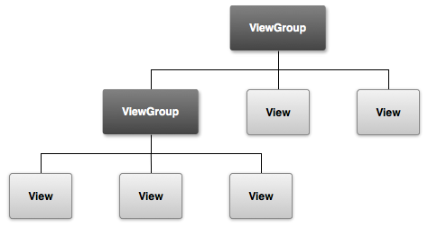
Elements of a ui

Slide 4
Viewgroup and view
ViewGroup can contain Views
A View can contain widgets such as buttons, EditText, TextView…
They are grouped in a tree structure

Slide 5
Creating views
Define a view/widget in the layout XML file and assign it a unique ID:
<Button
android:id="@+id/my_button"
android:layout_width="wrap_content" android:layout_height="wrap_content" android:text="@string/my_button_text"/>

Slide 6
View cont’d
Then create an instance of the view object and capture it from the layout (typically in the onCreate()method):
Button myButton = (Button) findViewById(R.id.my_button);

Slide 7
Views cont’d
Defining IDs for view objects is important when creating a RelativeLayout.
In a relative layout, sibling views can define their layout relative to another sibling view, which is referenced by the unique ID.
An ID need not be unique throughout the entire tree, but it should be unique within the part of the tree you are searching (which may often be the entire tree, so it's best to be completely unique when possible).

Slide 8
Layouts Note that layouts are viewgroups

Slide 9
Linear layout example
<?xml version="1.0" encoding="utf-8"?> <LinearLayout xmlns:android="http://schemas.android.com/apk/res/android" android:layout_width="fill_parent" android:layout_height="fill_parent" android:orientation="vertical" >
<TextView android:id="@+id/text" android:layout_width="wrap_content" android:layout_height="wrap_content" android:text="I am a TextView" />
<Button android:id="@+id/button" android:layout_width="wrap_content" android:layout_height="wrap_content" android:text="I am a Button" /> </LinearLayout>

Slide 10
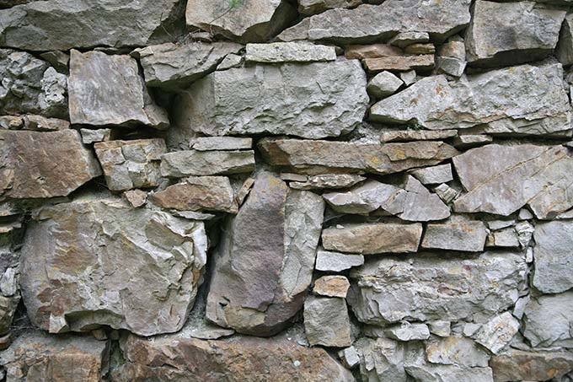

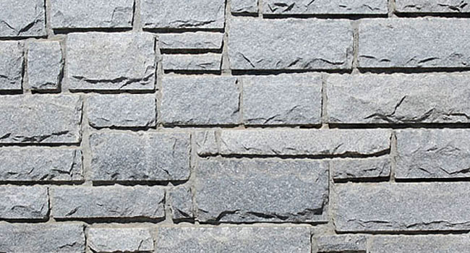
Layouts: Try to be simple and elegant

Slide 11
Declaring layouts
XML use is recommended due to its simplicity and easy visualization of the design
You can create layouts in code but difficult to debug
XML allows you to create layouts customization for different orientations (landscape, portrait)
XML allows you to create Internationalized layouts (different languages, same app)

Slide 12
Linear layout
Vertical Alignment
Horizontal Alignment
Similar to same layout in App Inventor

Slide 13
Linear layout example
<?xml version="1.0" encoding="utf-8"?> <LinearLayout xmlns:android="http://schemas.android.com/apk/res/android" android:layout_width="match_parent" android:layout_height="match_parent" android:orientation="vertical" > <TextView android:id="@+id/text" android:layout_width="wrap_content" android:layout_height="wrap_content" android:text="Hello, I am a TextView" /> <Button android:id="@+id/button" android:layout_width="wrap_content" android:layout_height="wrap_content" android:text="Hello, I am a Button" /> </LinearLayout>

Slide 14
Relative layout
<?xml version="1.0" encoding="utf-8"?> <RelativeLayout xmlns:android="http://schemas.android.com/apk/res/android" android:layout_width="match_parent" android:layout_height="match_parent" android:paddingLeft="16dp" android:paddingRight="16dp" > <EditText android:id="@+id/name" android:layout_width="match_parent" android:layout_height="wrap_content" android:hint="@string/reminder" /> <Spinner android:id="@+id/dates" android:layout_width="0dp" android:layout_height="wrap_content" android:layout_below="@id/name" android:layout_alignParentLeft="true" android:layout_toLeftOf="@+id/times" /> <Spinner android:id="@id/times" android:layout_width="96dp" android:layout_height="wrap_content" android:layout_below="@id/name" android:layout_alignParentRight="true" /> <Button android:layout_width="96dp" android:layout_height="wrap_content" android:layout_below="@id/times" android:layout_alignParentRight="true" android:text="@string/done" /> </RelativeLayout>
Widgets are positioned relative to each other.
Use layout parameters such as:
android:layout_toRightOf=“@id/btnx”
Android:layout_below=“@id/times”

Slide 15
List view
Displays a list of scrollable items.
The list items are automatically inserted to the list using an Adapter that pulls content from a source such as an array or database query and converts each item result into a view that's placed into the list.
See: http://www.tutorialspoint.com/android/android_list_view.htm

Slide 16
List view example
<LinearLayout xmlns:android="http://schemas.android.com/apk/res/android"
xmlns:tools="http://schemas.android.com/tools"
android:layout_width="match_parent"
android:layout_height="match_parent"
android:orientation="vertical"
tools:context=".ListActivity" >
<ListView
android:id="@+id/mobile_list"
android:layout_width="match_parent"
android:layout_height="wrap_content" >
</ListView>
</LinearLayout>

Slide 17
Grid view
GridView is a ViewGroup that displays items in a two-dimensional, scrollable grid.
The grid items are automatically inserted to the layout using a ListAdapter

Slide 18
Example (similar to java grid layout)
<?xml version="1.0" encoding="utf-8"?>
<GridView xmlns:android="http://schemas.android.com/apk/res/android"
android:id="@+id/gridview"
android:layout_width="fill_parent"
android:layout_height="fill_parent"
android:columnWidth="90dp"
android:numColumns="auto_fit"
android:verticalSpacing="10dp"
android:horizontalSpacing="10dp"
android:stretchMode="columnWidth"
android:gravity="center"
/>

Slide 19
Input controls/widgets

Slide 20
Buttons
Text Fields
Label
Checkboxes
Radio Buttons
Spinners
Pickers

Slide 21
buttons
<Button
android:layout_width="wrap_content"
android:layout_height="wrap_content"
android:text="@string/button_text"
... />
<ImageButton
android:layout_width="wrap_content"
android:layout_height="wrap_content"
android:src="@drawable/button_icon"
... />

Slide 22
Onclick button listener
In OnCreate method:
Button button = (Button) findViewById(R.id.button_send);
button.setOnClickListener( new View.OnClickListener() {
public void onClick(View v) {
// Do something in response to button click
}
});
Details: http://developer.android.com/guide/topics/ui/controls/button.html

Slide 23
Text fields
<EditText
android:id="@+id/email_address"
android:layout_width="fill_parent"
android:layout_height="wrap_content"
android:hint="@string/email_hint"
android:inputType="textEmailAddress" />

Slide 24
Label (textview)
<TextView
android:id="@+id/text_id"
android:layout_width="300dp"
android:layout_height="200dp"
android:capitalize="characters"
android:text="hello_world"
android:textColor="@android:color/holo_blue_dark"
android:textColorHighlight="@android:color/primary_text_dark"
android:layout_centerVertical="true"
android:layout_alignParentEnd="true"
android:textSize="50dp"/>

Slide 25
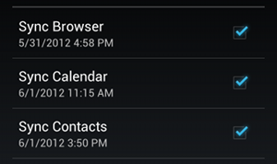
checkboxes
<?xml version="1.0" encoding="utf-8"?>
<LinearLayout xmlns:android="http://schemas.android.com/apk/res/android"
android:orientation="vertical"
android:layout_width="fill_parent"
android:layout_height="fill_parent">
<CheckBox android:id="@+id/checkbox_meat"
android:layout_width="wrap_content"
android:layout_height="wrap_content"
android:text="@string/meat"
android:onClick="onCheckboxClicked"/>
<CheckBox android:id="@+id/checkbox_cheese"
android:layout_width="wrap_content"
android:layout_height="wrap_content"
android:text="@string/cheese"
android:onClick="onCheckboxClicked"/>
</LinearLayout>

Slide 26
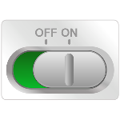
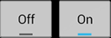
Toggle buttons
<ToggleButton
android:layout_width="wrap_content"
android:layout_height="wrap_content"
android:text="On"
android:id="@+id/toggleButton"
android:checked="true"
android:layout_below="@+id/imageButton"
android:layout_toLeftOf="@+id/imageButton"
android:layout_toStartOf="@+id/imageButton" />

Slide 27
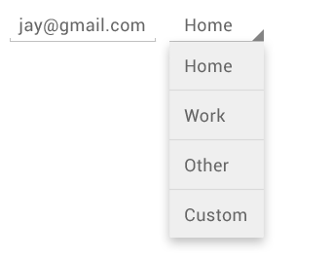
spinners
<Spinner
android:id="@+id/planets_spinner"
android:layout_width="fill_parent"
android:layout_height="wrap_content" />
To populate the spinner with a list of choices, you then need to specify a SpinnerAdapter in your Activity or Fragment source code.
The choices you provide for the spinner can come from any source, but must be provided through an SpinnerAdapter, such as an ArrayAdapter if the choices are available in an array or a CursorAdapter if the choices are available from a database query.
See: http://developer.android.com/guide/topics/ui/controls/spinner.html
Notes:
To populate the spinner with a list of choices, you then need to specify a SpinnerAdapter in your Activity or Fragment source code.

Slide 28
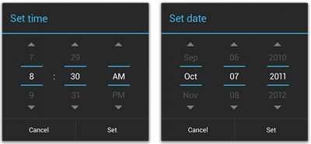
pickers
See: http://developer.android.com/guide/topics/ui/controls/pickers.html

Slide 29
Event handlers
Create an event listener
Register event listener
Create an event handler
Event occurs
Event listener fires
Handler is called
Example:

Slide 30
package com.example.myapplication;
public class MainActivity extends ActionBarActivity {
Button b1; //declare a button
@Override
protected void onCreate(Bundle savedInstanceState) {
super.onCreate(savedInstanceState);
setContentView(R.layout.activity_main); //Select activity

Slide 31
b1=(Button)findViewById(R.id.button); //Instantiate button
b1.setOnClickListener( new View.OnClickListener() { //Create listener & register
@Override
public void onClick(View v) { //Event handler
TextView txtView = (TextView) findViewById(R.id.textView); //Create textview
txtView.setTextSize(25); //Set textview size
}
});

Slide 32
fragments
Is a part of an Activity; a sub-activity
Can receive input events
Has its own lifecycle but can not exist outside Activity
A fragment can be added or removed while the owner Activity is running
It can be re-used

Slide 33
Create fragment in java
import android.os.Bundle; import android.support.v4.app.Fragment; import android.view.LayoutInflater; import android.view.ViewGroup; public class ArticleFragment extends Fragment { @Override public View onCreateView(LayoutInflater inflater, ViewGroup container, Bundle savedInstanceState) { // Inflate the layout for this fragment return inflater.inflate(R.layout.article_view, container, false); } }

Slide 34
Lifecycle methods
Fragments like Activities have lifecycle methods
The key one is onCreateView() which is mandatory
In Activities, onCreate() is mandatory
Others are:
onStart()
onResume() - app running
onPause() - app visible in the background
onStop() - app hidden in the background
onDestry() – app removed from memory
onRestart() – app restored from onStop() condition – made visible in foreground
When app is launched, onCreate(), onStart() and onResume() are called()

Slide 35
Or Add a Fragment to an Activity using XML
<LinearLayout xmlns:android="http://schemas.android.com/apk/res/android" android:orientation="horizontal" android:layout_width="fill_parent" android:layout_height="fill_parent"> <fragment android:name="com.example.android.fragments.HeadlinesFragment" android:id="@+id/headlines_fragment" android:layout_weight="1" android:layout_width="0dp" android:layout_height="match_parent" /> <fragment android:name="com.example.android.fragments.ArticleFragment" android:id="@+id/article_fragment" android:layout_weight="2" android:layout_width="0dp" android:layout_height="match_parent" /> </LinearLayout>

Slide 36
apply the layout to your activity:

Slide 37
Exercise: temperature converter – Fahrenheit to Celsius
Requirements – Interface, language, platform
Design – UI,…
Construction –
UI – XML
Activity template
UI elements
Event listeners and handlers
Testing
Deployment
Submit as Bitbucket link

Slide 38
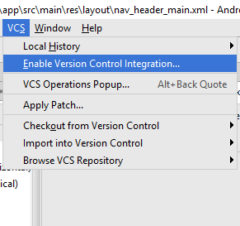
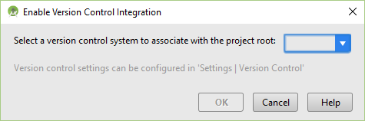
Vcs - Bitbucket
Create free account
Create repository (Git)
Download and install Git on your PC
Create project in Android Studio
Configure VCS (Git)
Push project (Give Bitbucket repository URL)

Slide 39
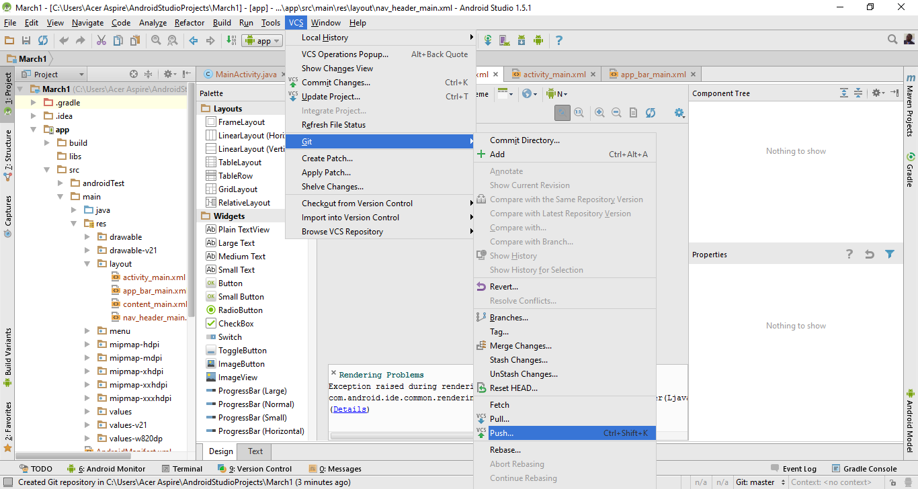
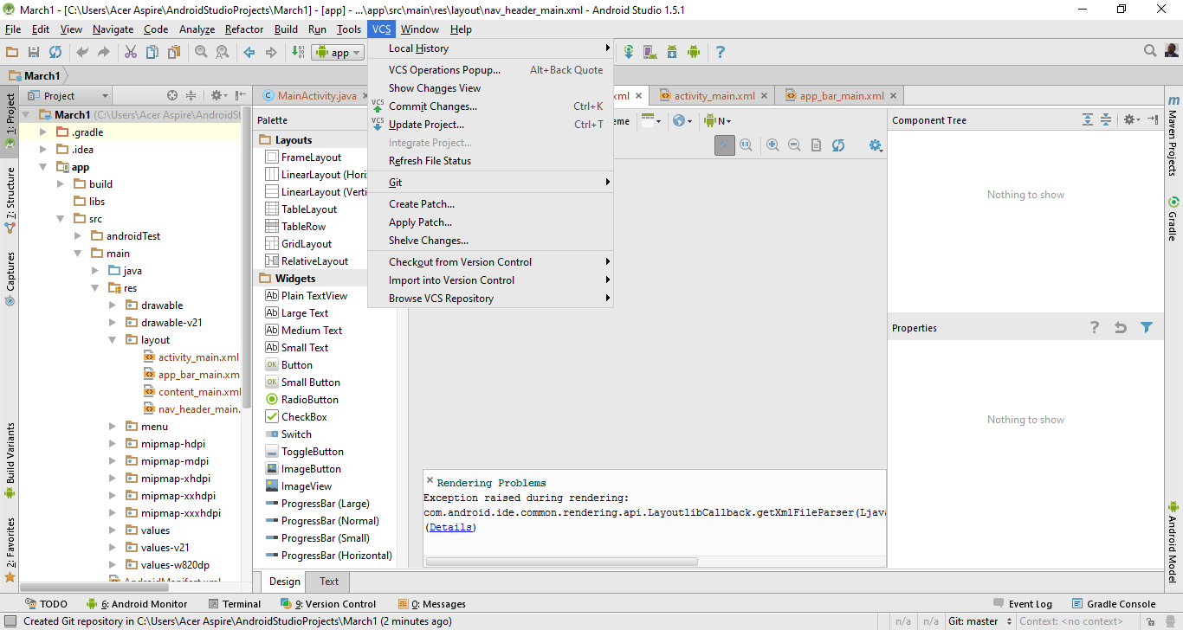
A/studio After vcs configuration

Slide 40
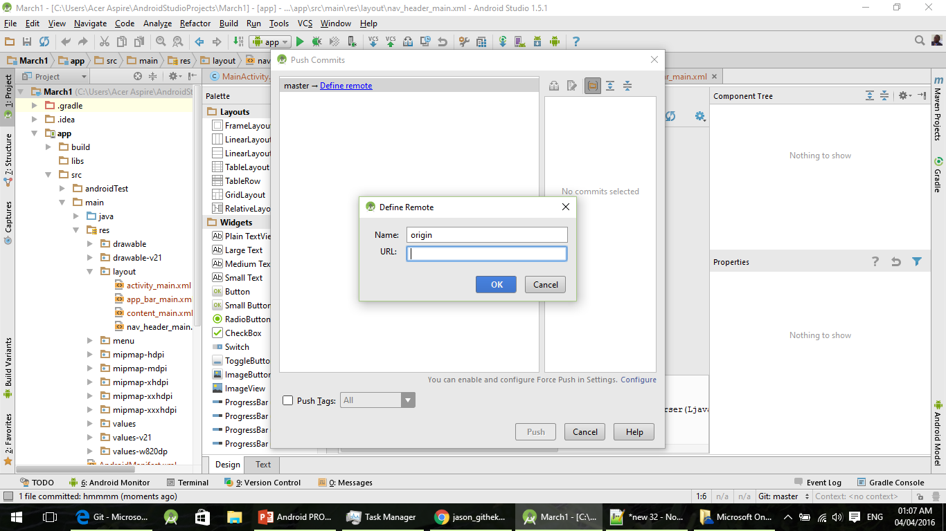
Define repository in a/studio

Slide 41
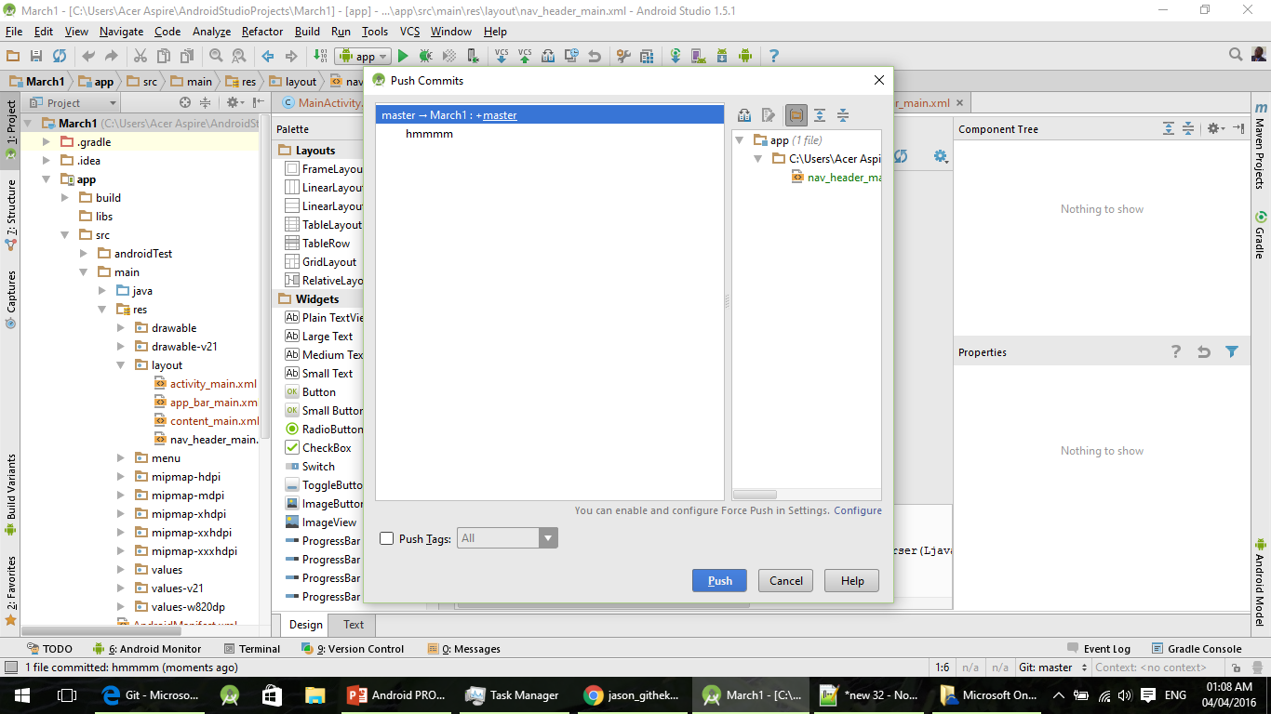
Ready to push

Slide 42
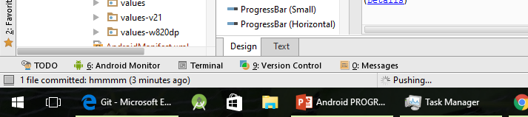
pushing

Slide 43
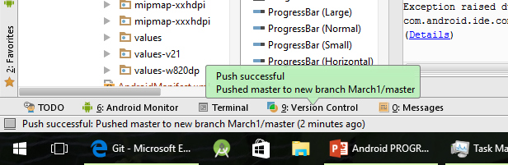
Push complete

Slide 44
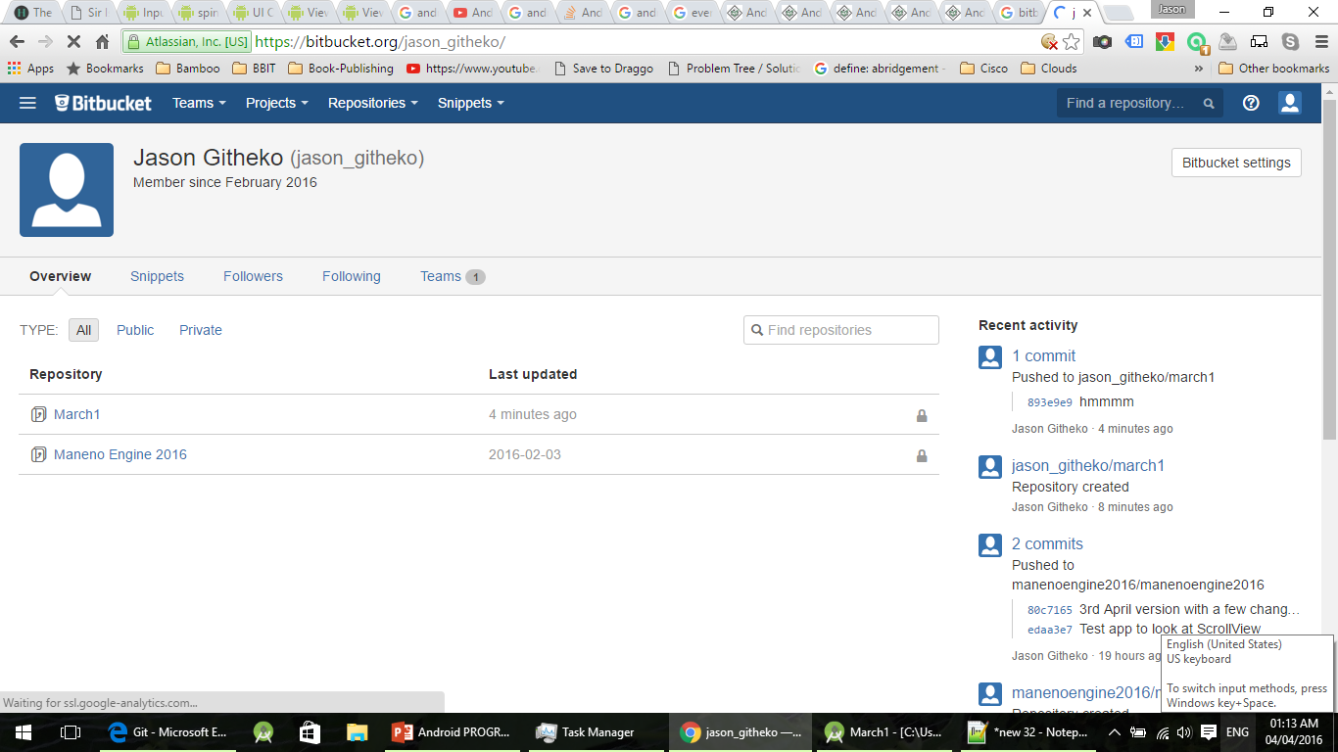
Bitbucket post-push

Slide 45
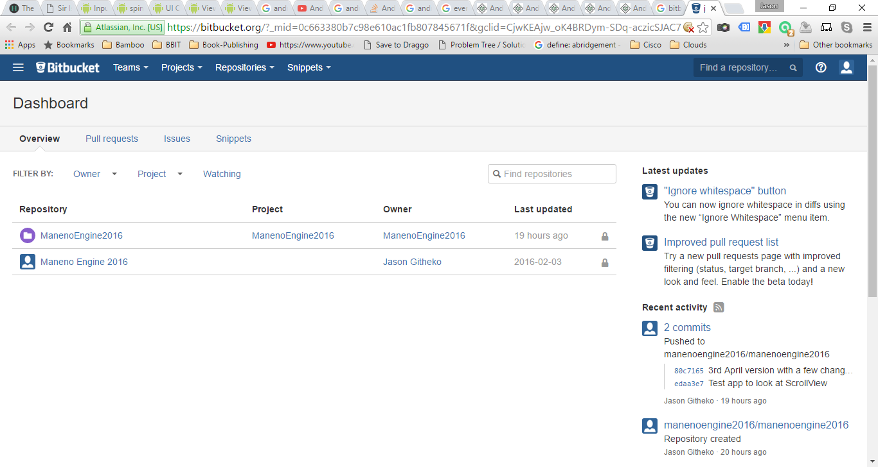
bitbucket

Slide 46
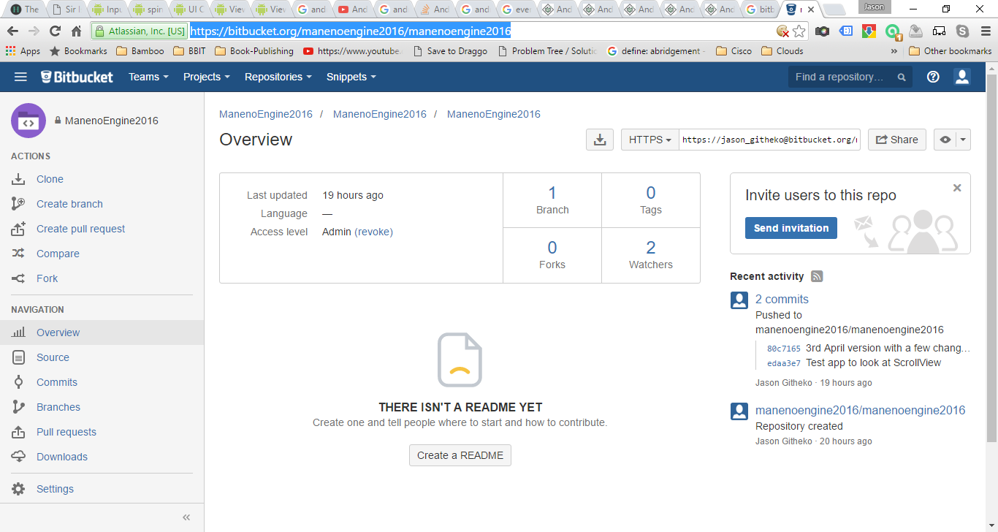
Repository url

Slide 47
